Slide 1
System Features
There are 3 user :
Admin
Add new staff
Can ban/kick user
Add/Edit game’s page bulletin
Can ban/kick user
Check/approve purchase
Check/approve game registration
User
Can register & log into the system.
Can edit profile.
Can Purchase game.
Can request to join developer group.
Can request to create developer group.
Can download free game.
Can comment on comment section on game’s page and developer’s page

Slide 2
Cont: System Features
Developer
Can edit information on developed game’s game page
Can request to upload and release new game.
Can register for new game.
Can approve member requested to join group.
Group admin can kick user from group.
Group admin can approve group member request to upload and release new game.
Member can send request of approved request to upload/release game to admin.
Member can send request to upload and release new game to Developer Admin.
Can comment on developer page section.

Slide 3
Hardware/Software Requirements
Admin
Hardware
Device that can be use for developing
Device that can access internet
Software
Software for webpage developing
Software to access website
Operating System
User & Developer
Hardware
Device that can access internet
Software
Software to access website
Operating System

Slide 4
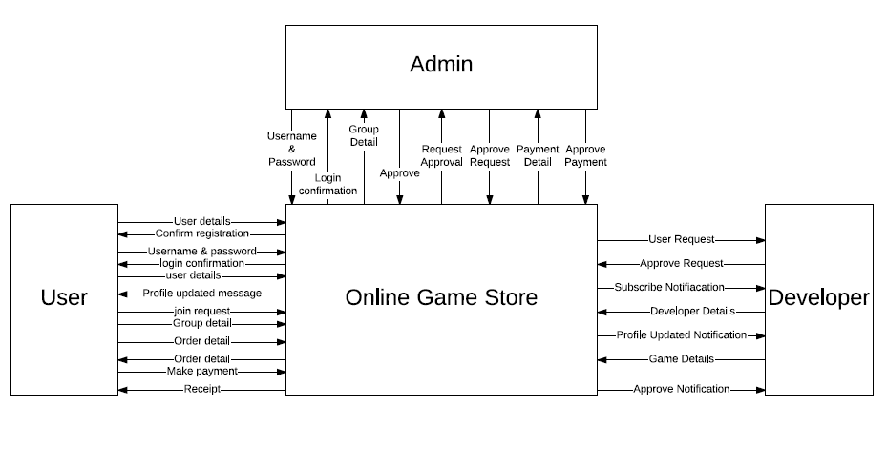
Context Diagram

Slide 5
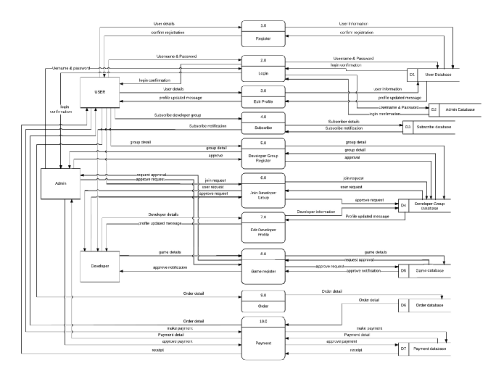
Data Flow Diagram

Slide 6
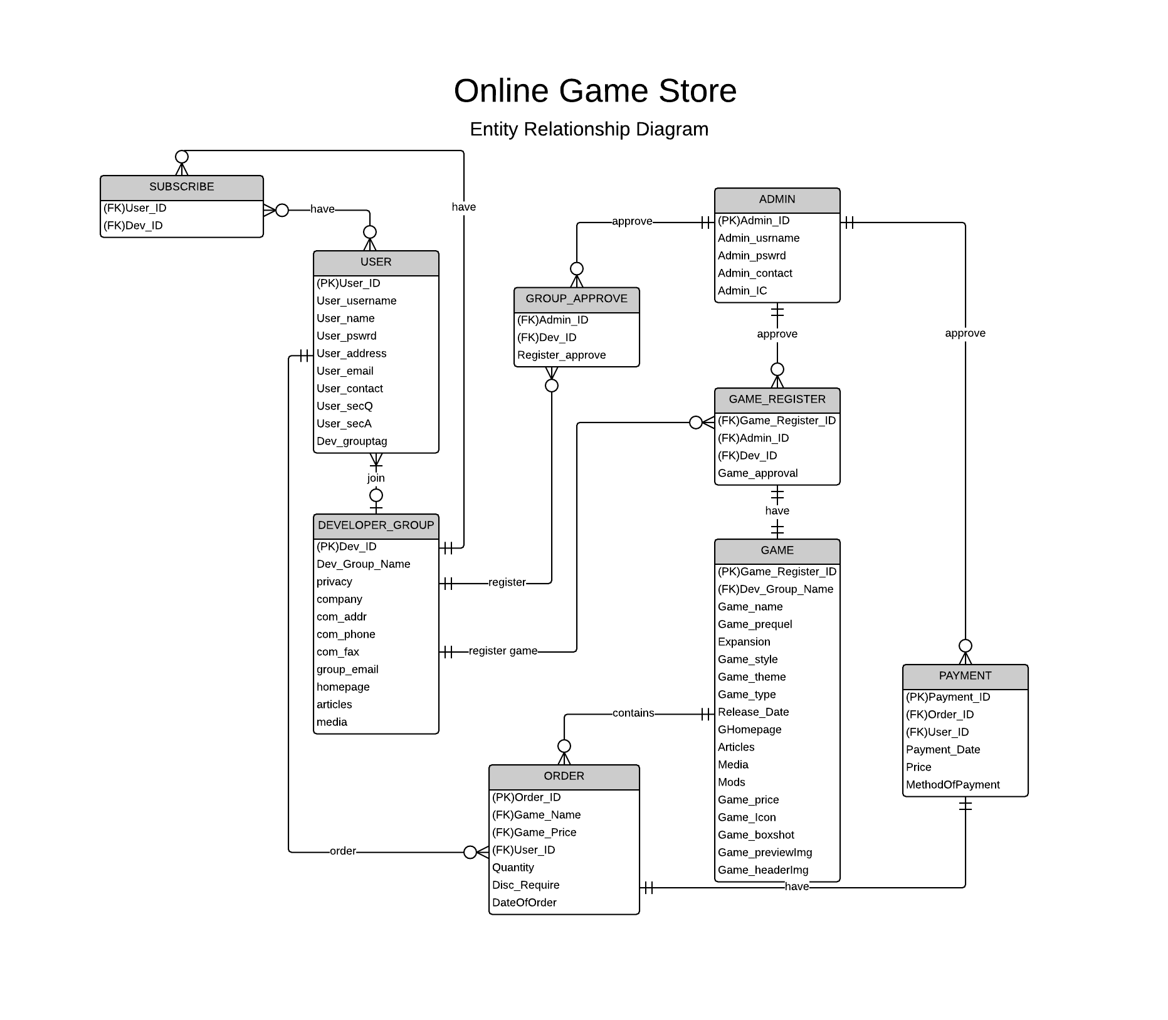
Entity Relationship Diagram

Slide 7
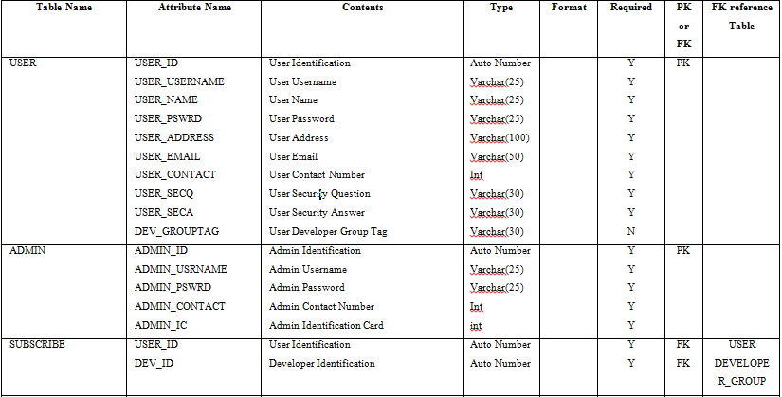
Data Dictionary

Slide 8
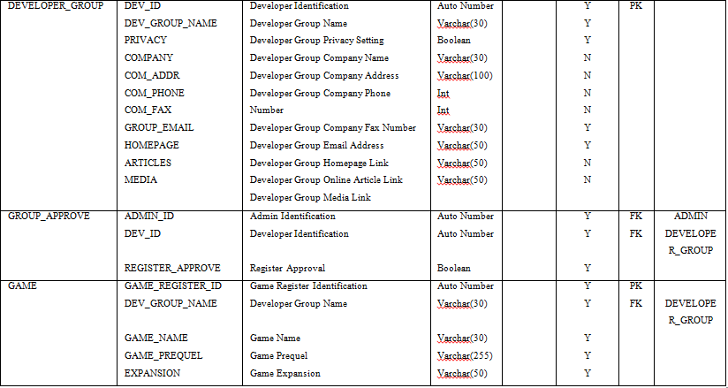

Slide 9
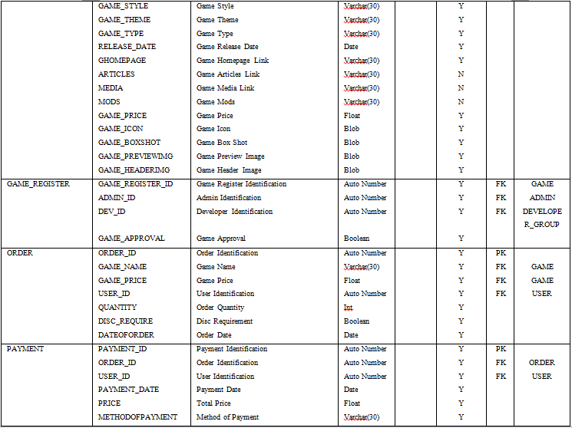

Slide 10
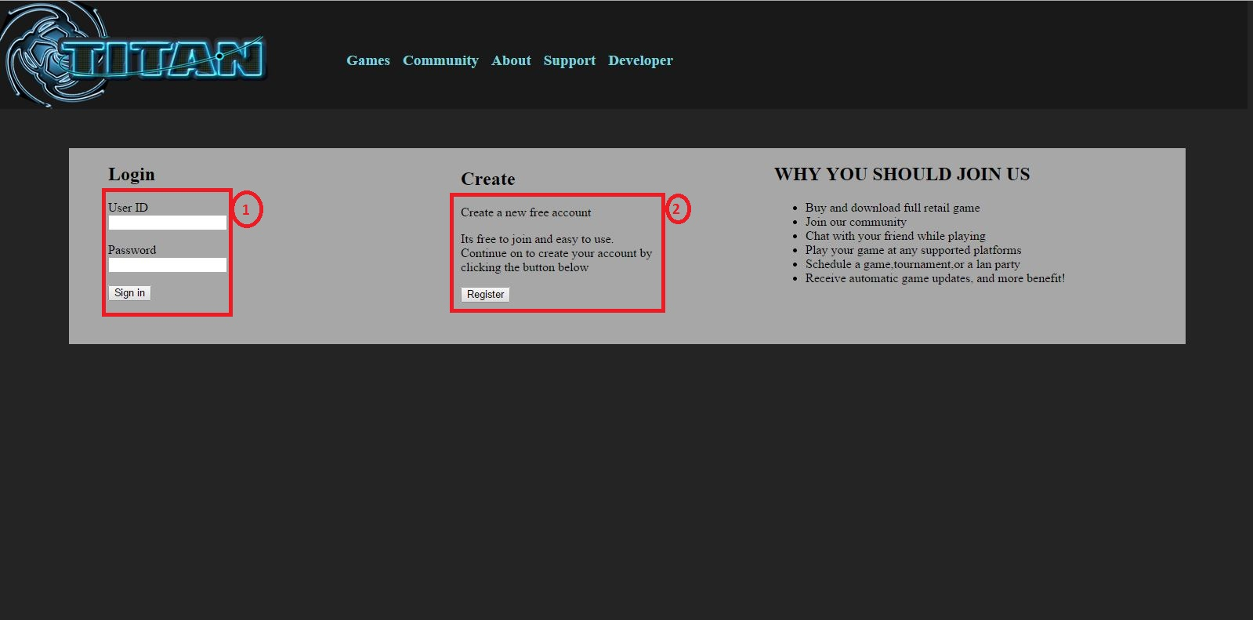
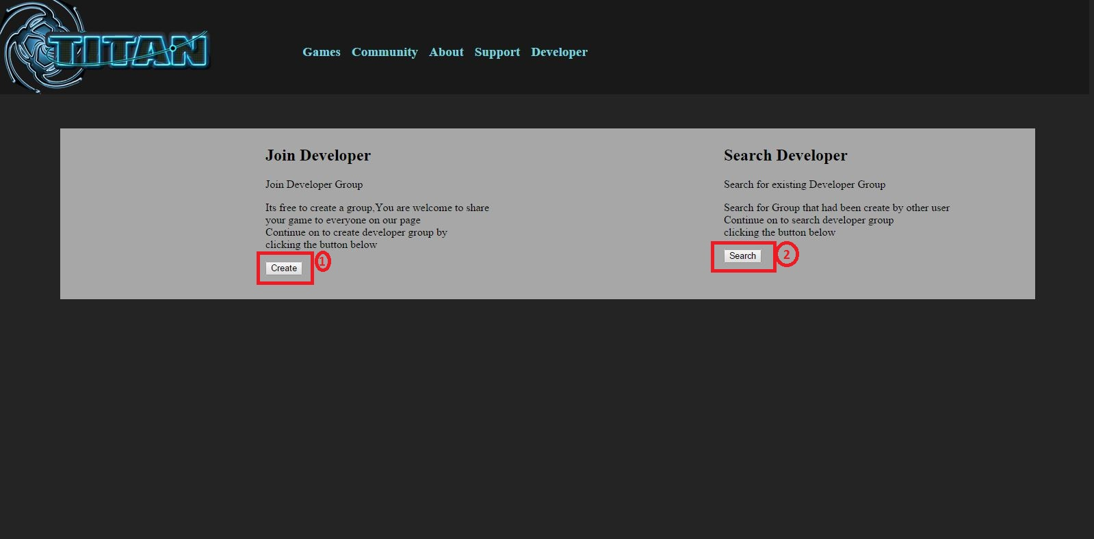
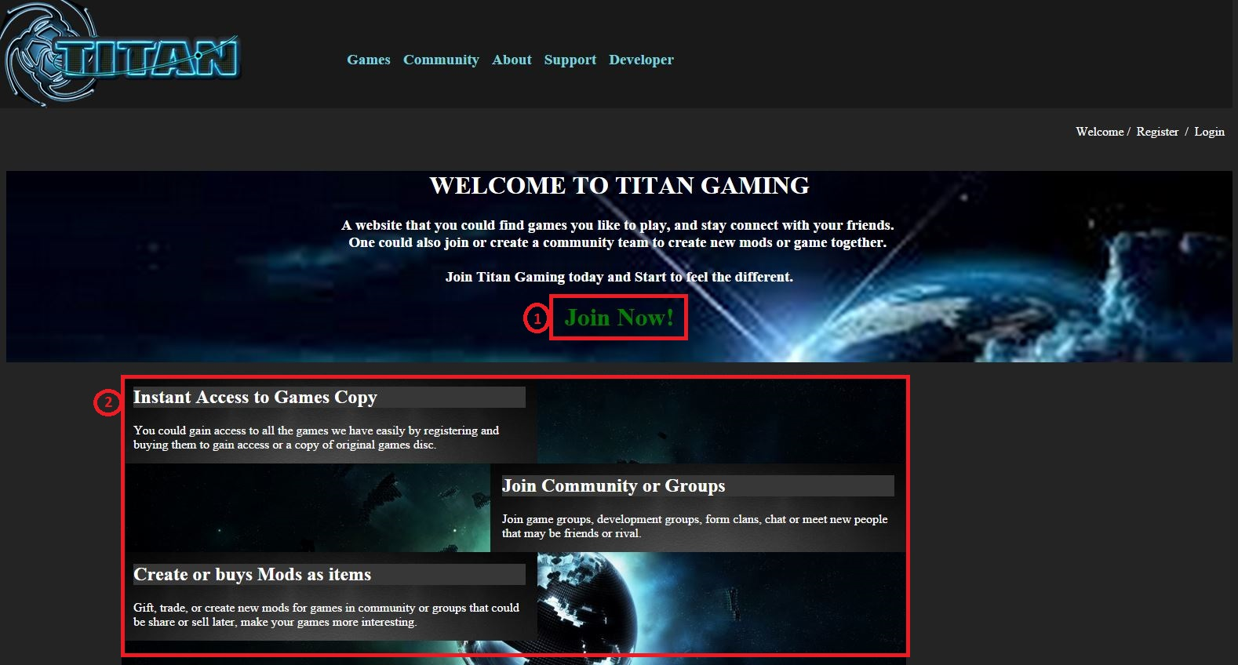
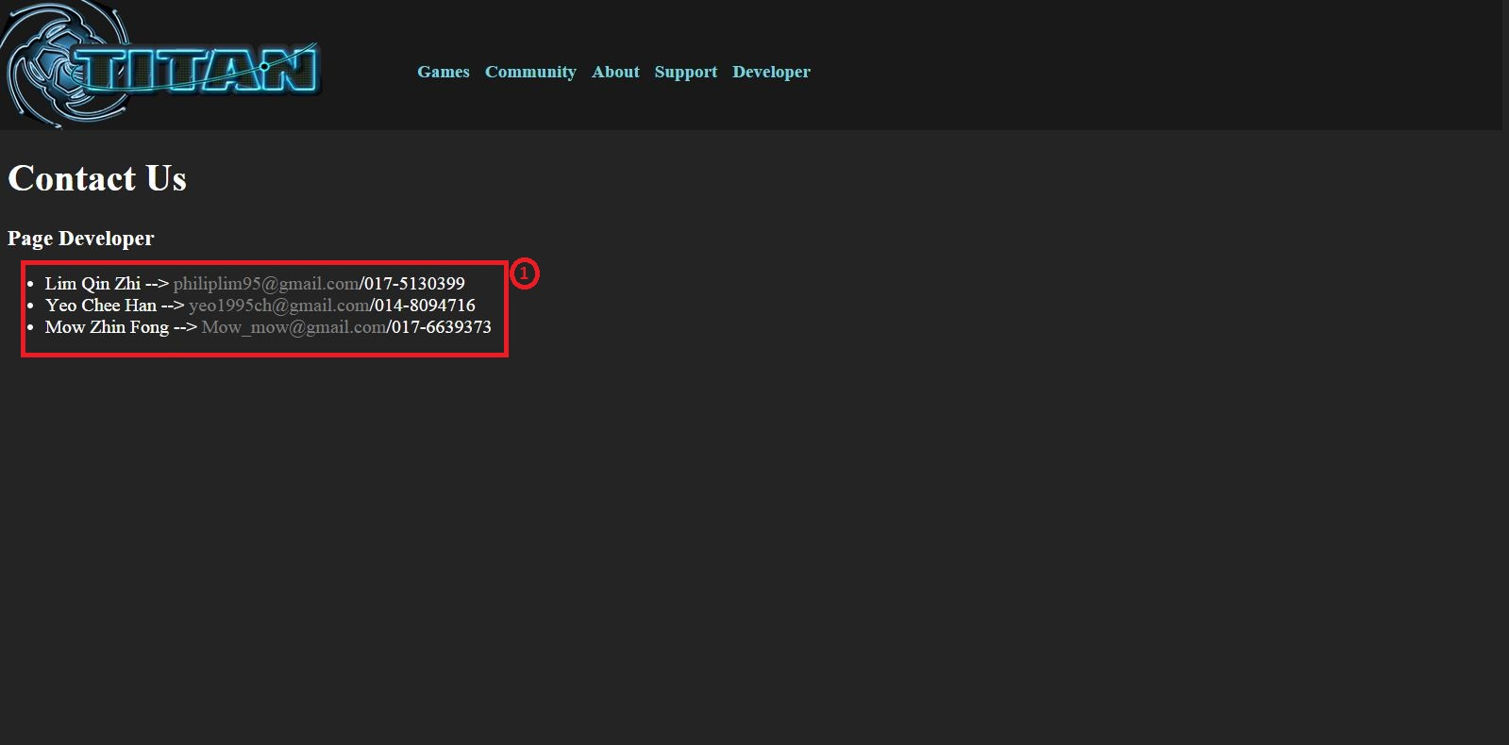
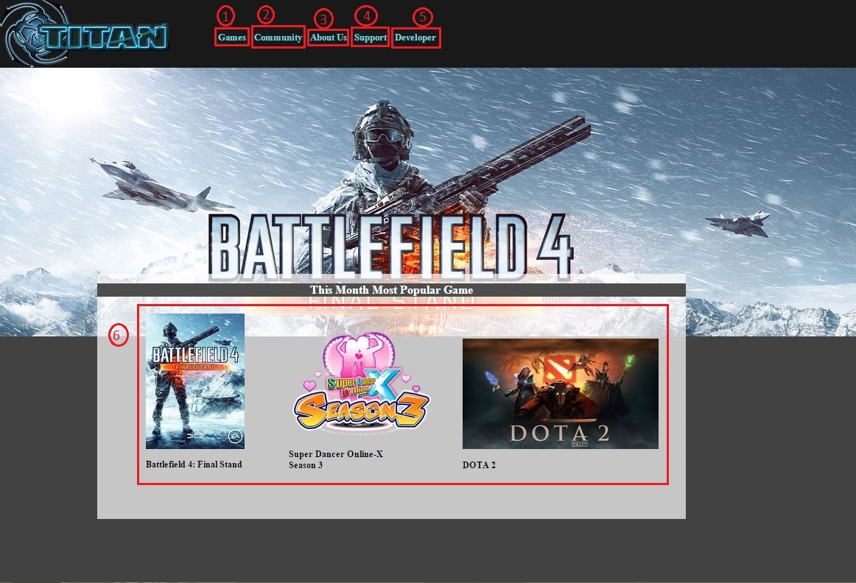
Prototype ScreenShot

Slide 11
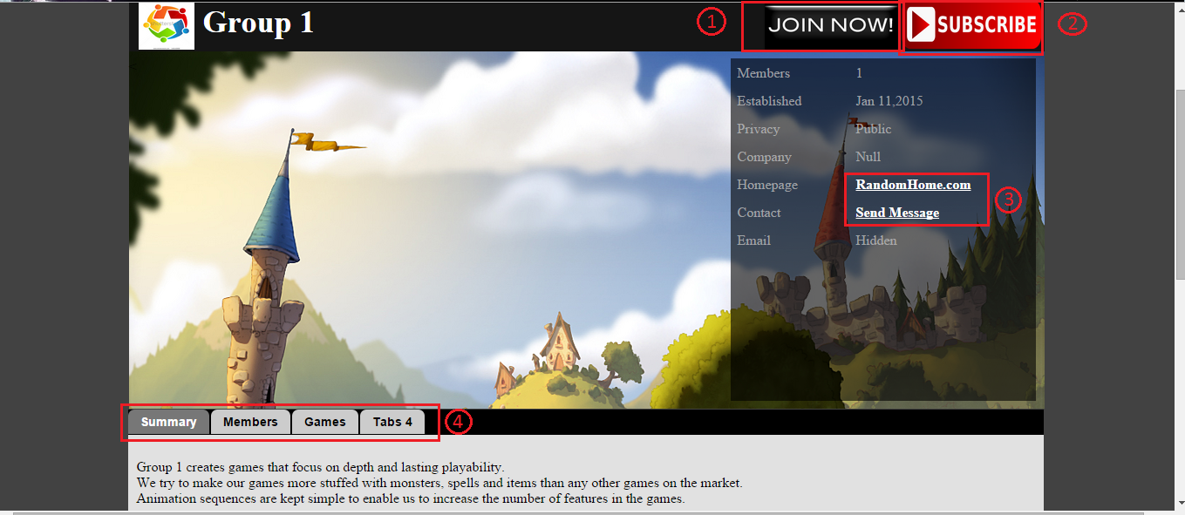
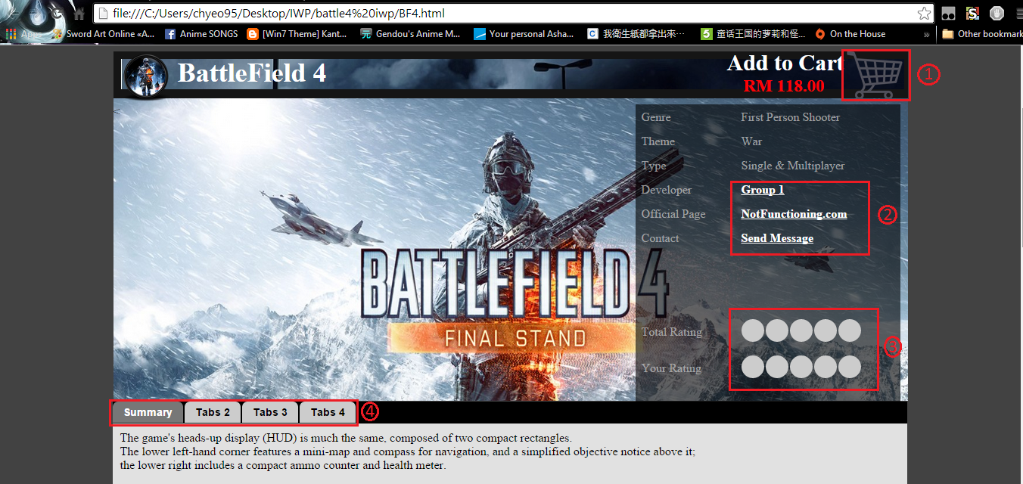
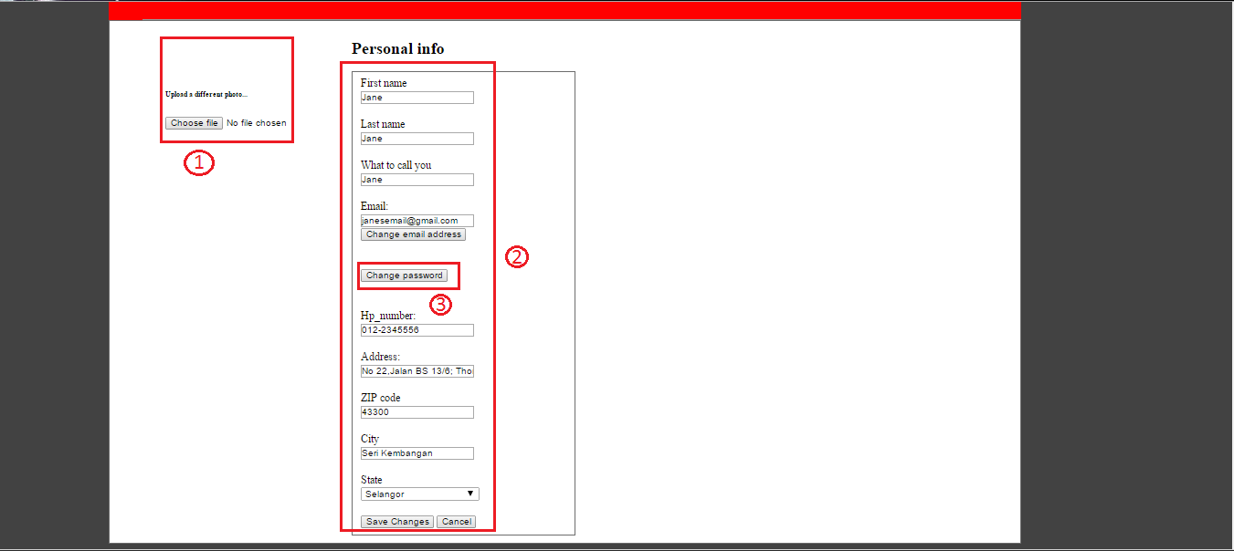
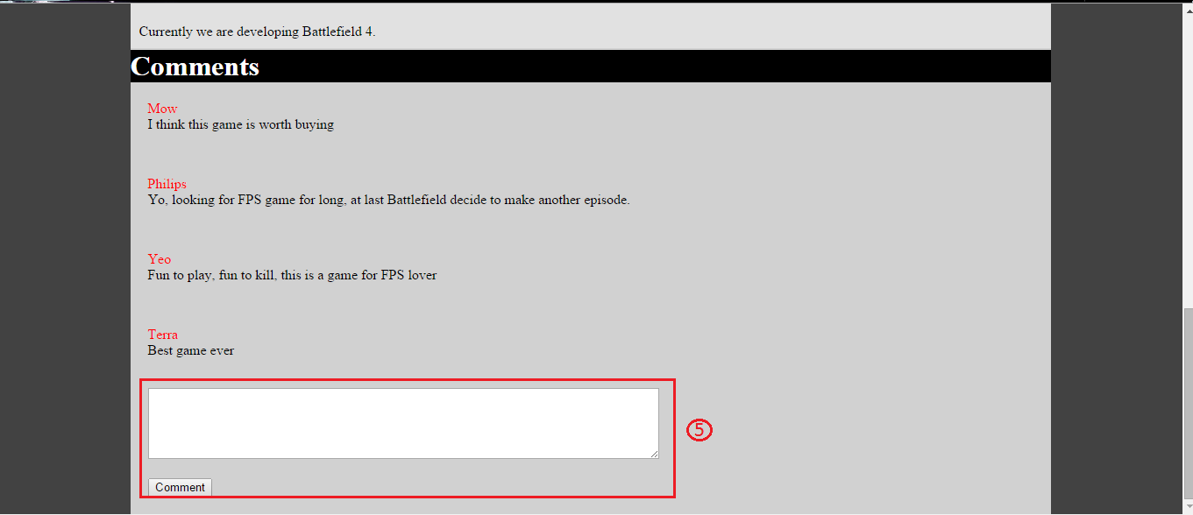
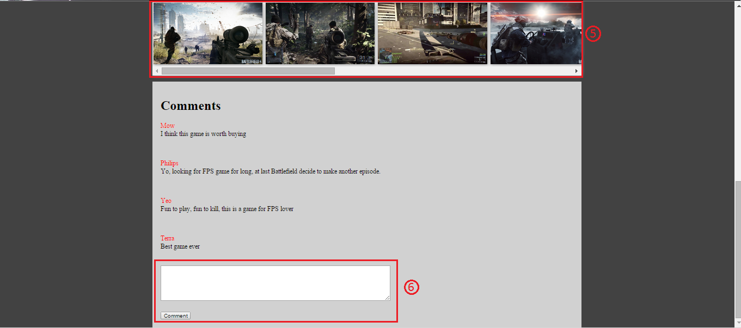
Continue …..

Slide 12
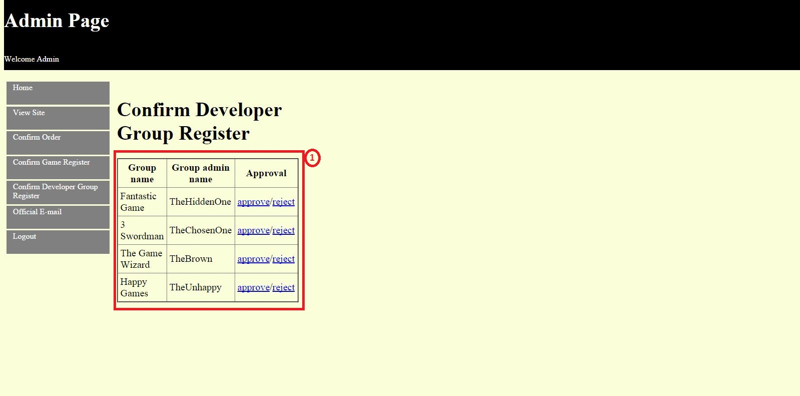
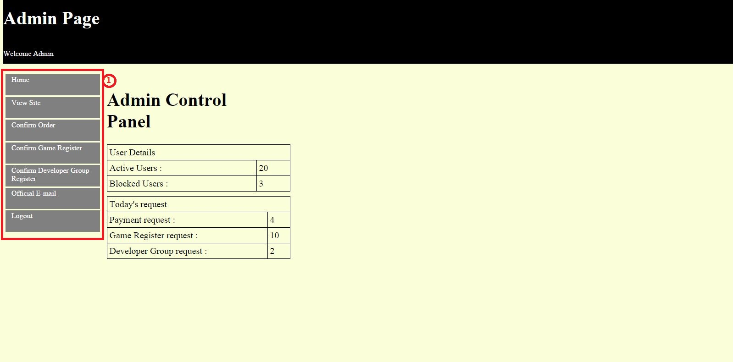
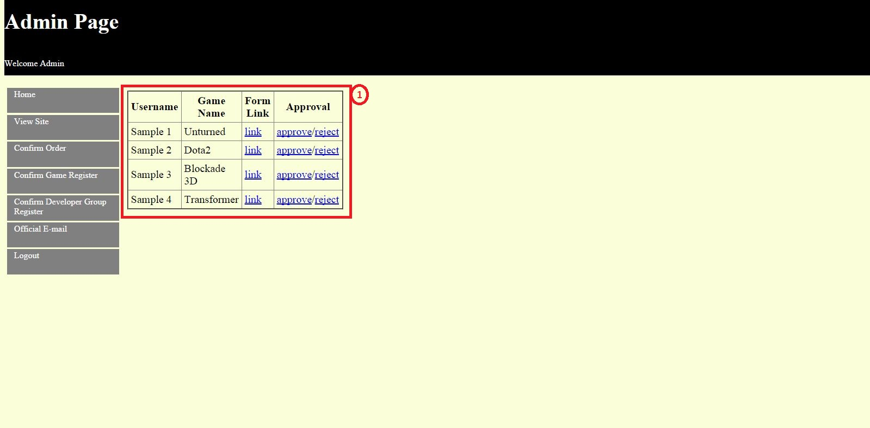
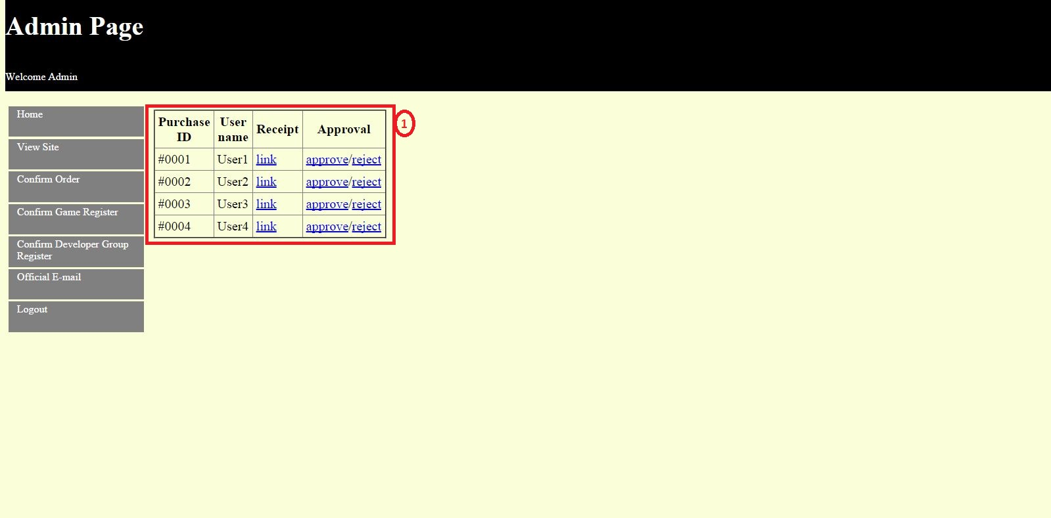
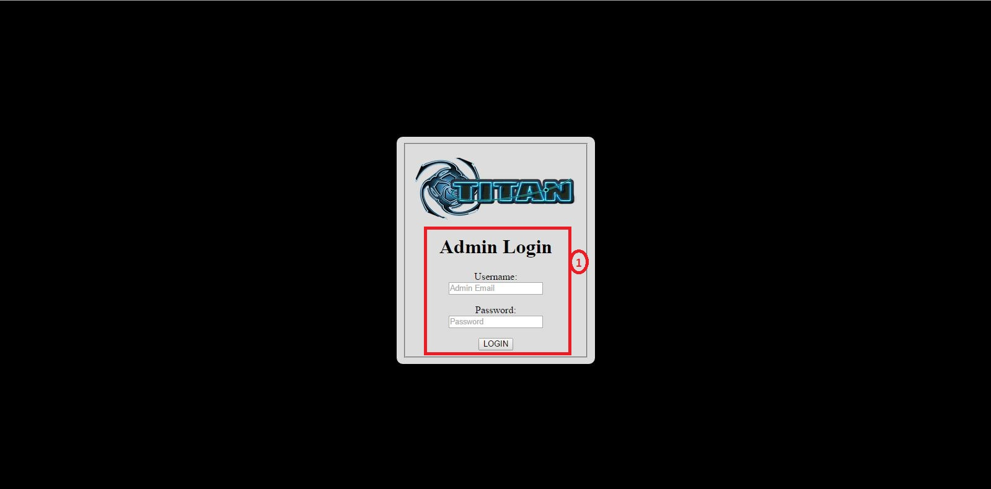
Continue…. Admin

Slide 13
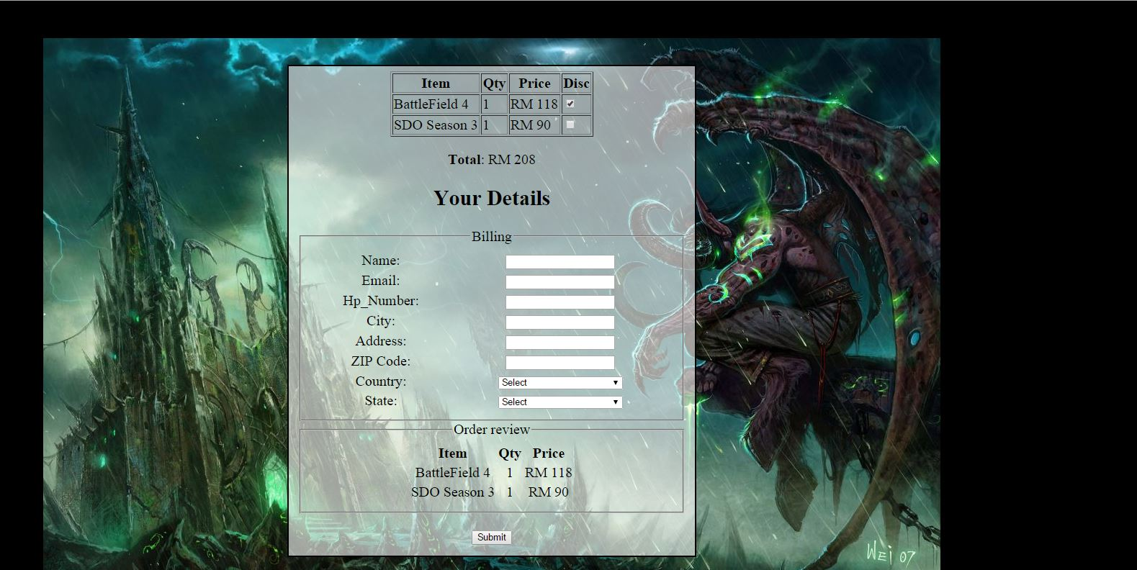
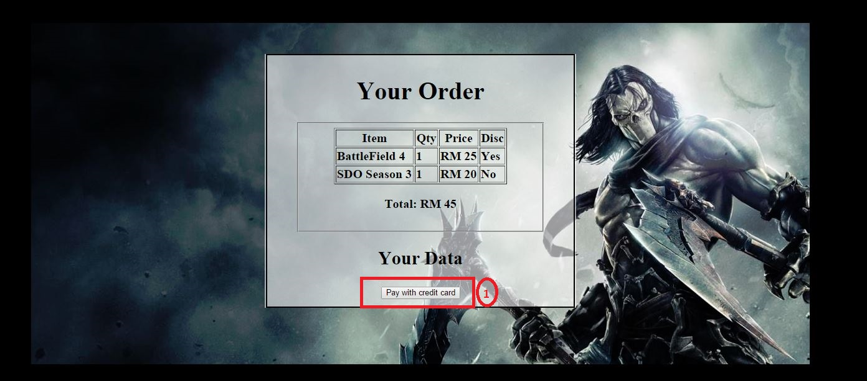
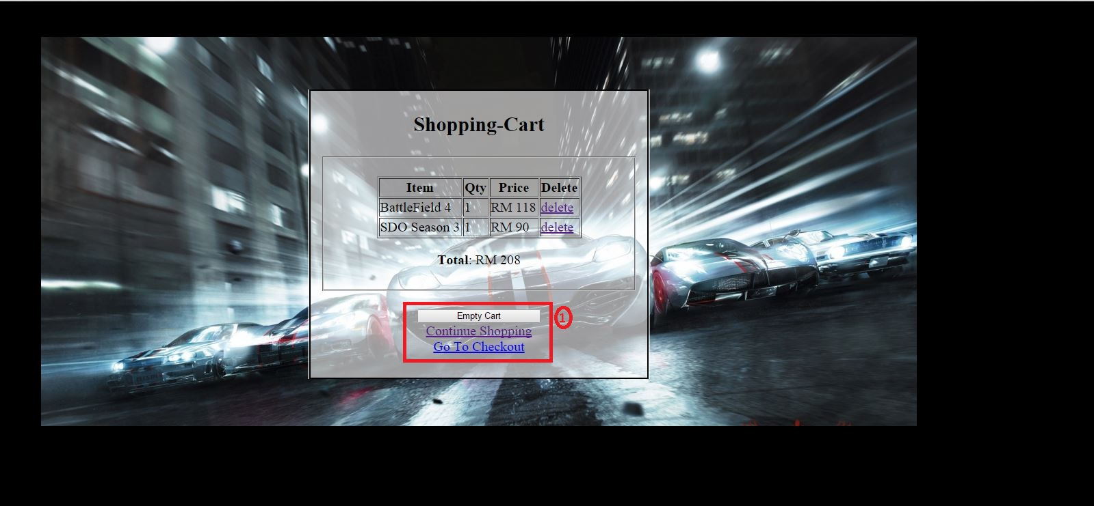
~~Purchase~~

Slide 14
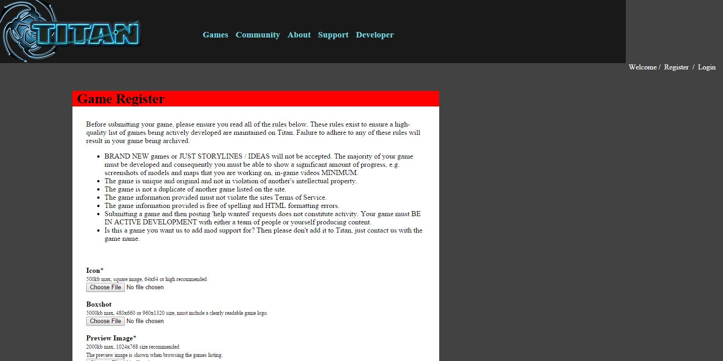
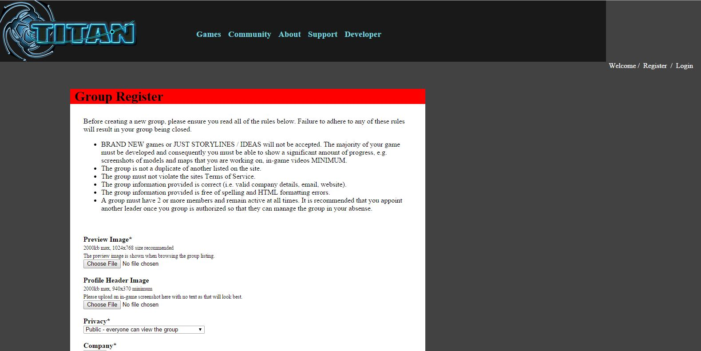
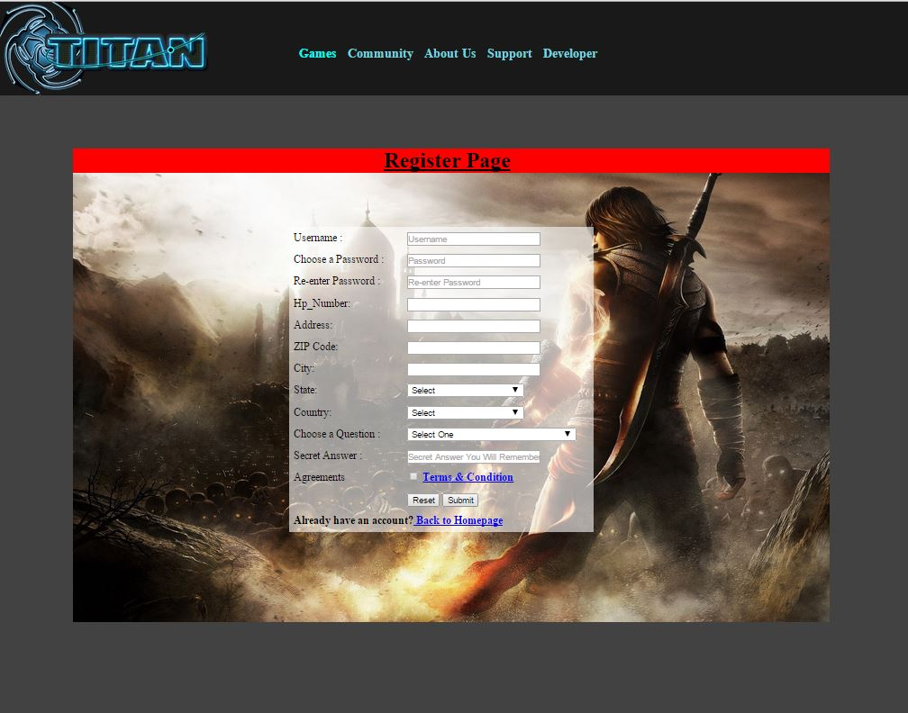
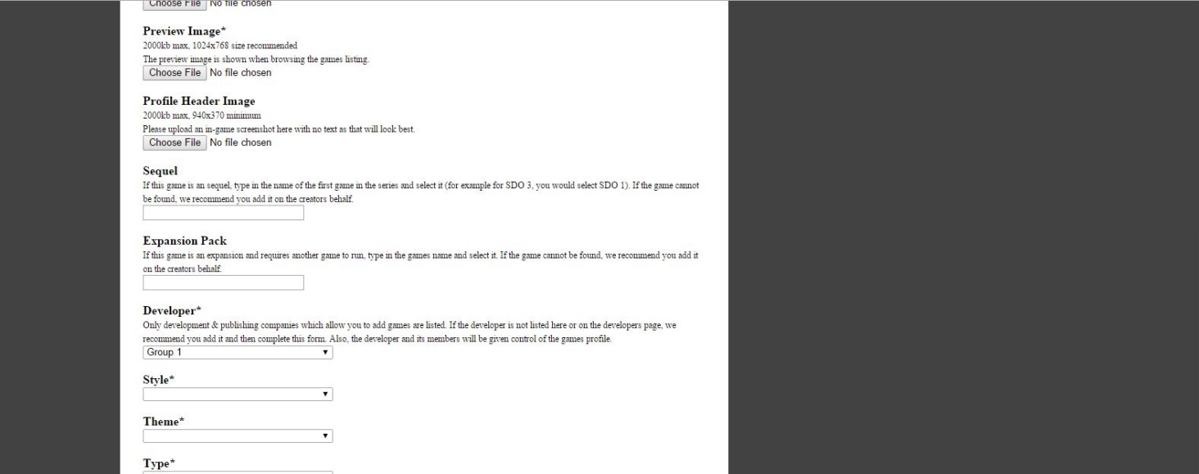
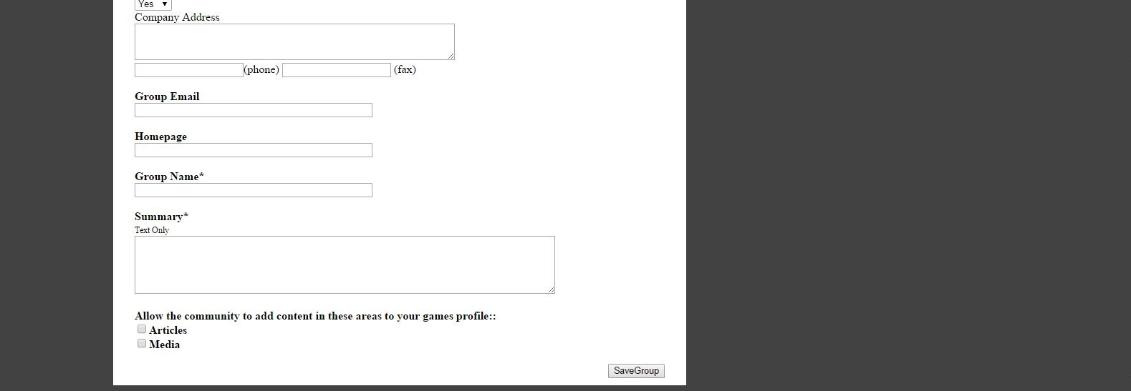
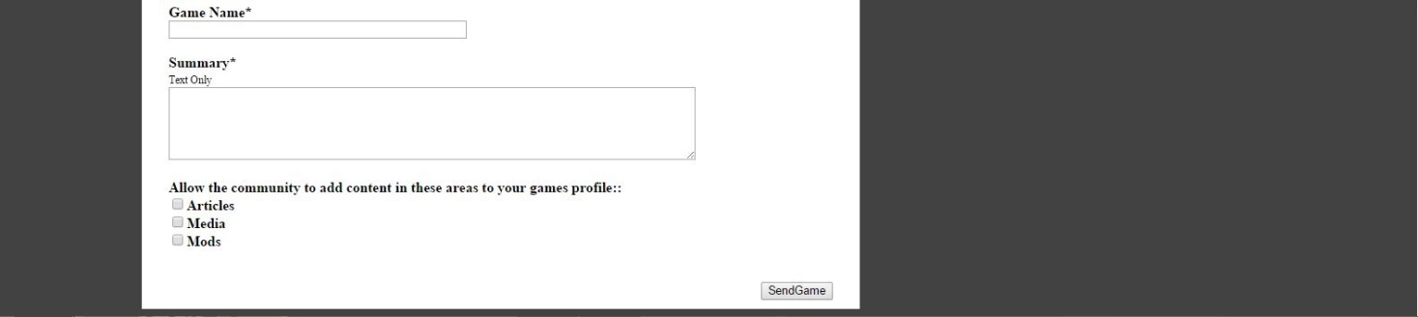
Register anything?

